Slide 1
Greenspot Grocer
Case Study Question
How can Greenspot Grocer, a rapidly growing online store, transition from an outdated spreadsheet system to a scalable database?
The new system should efficiently manage inventory, sales, and purchases while reducing data duplication.

Slide 2
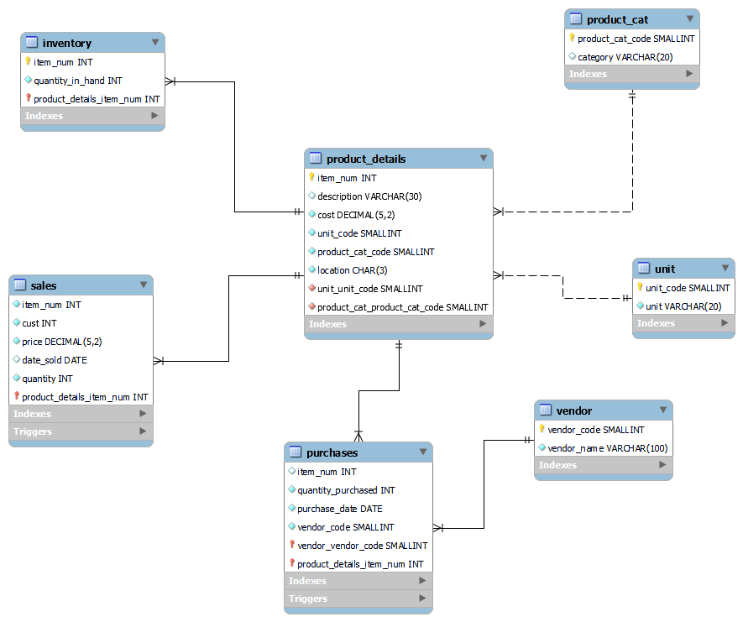
Greenspot Grocer
New Database Design

Slide 3
Greenspot Grocer
7 Related Tables
Main Tables:
ProductDetails
Purchases
Sales
Inventory
Supporting Tables
Unit
Vendor
Product_Cat

Slide 4
Greenspot Grocer
Crucial Tables
Product_Details Sales Purchases Inventory
Item_Num : Product Unique Number
Desc : Description of Product
Cost : Cost of Product
Unit_code : Code of Unit Used
Product_cat_code : Product type Code
Location : Block Location of Product
Item_Num : Product Unique Number
Cust : Customer Unique Number
Price : Price of 1 unit
Date : Date of sale
Quantity : Quantity sold
Item_Num : Product Unique Number
Purchase_Quantity : Quantity Purchased
Purchase_Date : Date of Purchase
Vendor_Code : Code of Vendor
Item_Num : Product Unique Number
Quantity_in_hand : Quantity Available in Inventory (Updated Automatically when a sale or purchase is made)

Slide 5
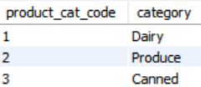
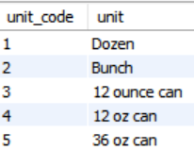
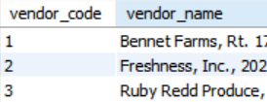
Greenspot Grocer
Supporting Tables for Normalization
Product_Cat Unit Vendor
Product_Cat_Code : Category Code
Category : Category Name
Unit_Code : Unit Code
Unit : Unit Name
Vendor_Code : Vendor Code
Vendor_Name : Name and Address of Vendor

Slide 6
Greenspot Grocer
Entity Relationship Diagram

Slide 7
Greenspot Grocer

Slide 8
Greenspot Grocer
New Database Advantages
1. Reduced redundancy and duplication.
2. Easy future expansion.
3. Centralized, consistent product data.
4. Efficient querying and reporting.
5. Simplified maintenance.

Slide 9
Greenspot Grocer
New Database Disadvantages
1. Complex queries for beginners
2. Requires multiple table joins
3. Potential performance issues with scale

Slide 10
Greenspot Grocer
Conclusion
This database design reduces duplication and ensures clear separation for recording sales and purchases.
Its structure supports scalability and future growth while maintaining data integrity.

Slide 11
Greenspot Grocer
Thank You

